Slide 1

Installation

Slide 2
Introduction
Open Source
Linux
Linux based OS

Slide 3
Why Ubuntu…?
Open Source
Free Of Cost
Desktop and Server edition
Large community Support
Frequent Updates

Slide 4
Ubuntu 18.04 LTS
Latest stable ubuntu version
Improvised GUI
Minimal and normal installation mode

Slide 5
ISO file
Single File
Perfect Representation of CD/DVD

Slide 6
Bootable USB Stick
Rufus
Yumi
PowerISO

Slide 7
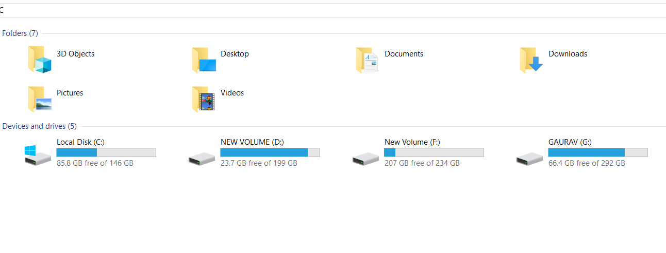
Disk Partitioning

Slide 8
Types of partitions
Primary Partition
Extended Partition
Logical Partition

Slide 9
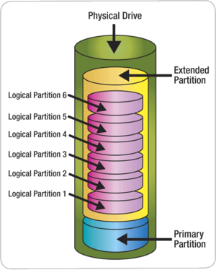
Disk partitions

Slide 10
Partitioning Scheme
MBR (Master Boot Record)
GPT (GUID Partition Table)

Slide 11
MBR vs GPT
Master Boot Record
Only 4 primary Partitions
Support volume up to 2TB
GUID Partition Table
Up to 128 partitions
Support up to 9 million TB

Slide 12
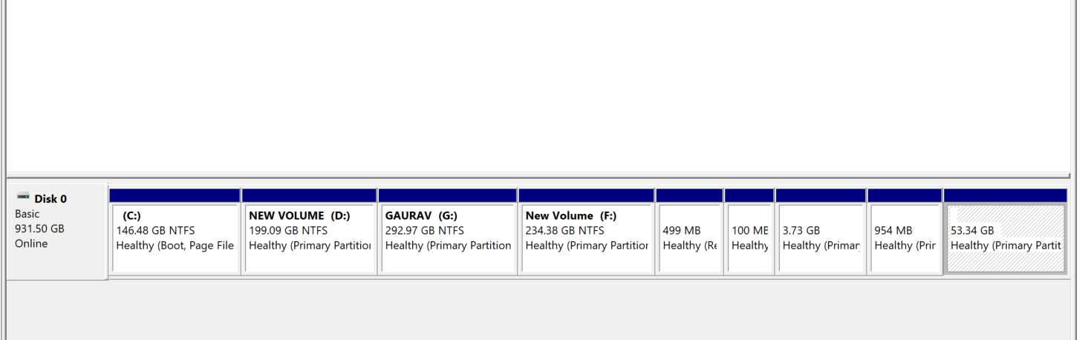
GPT Partition Scheme

Slide 13
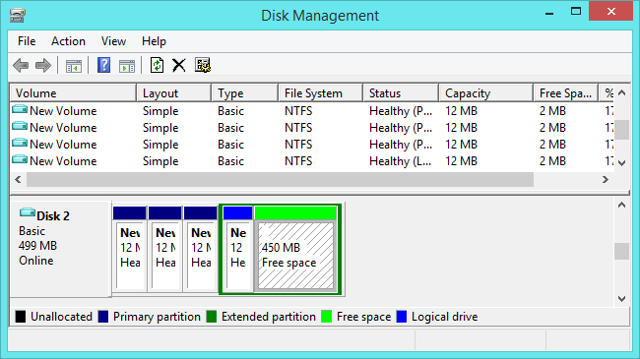
MBR Partition Scheme

Slide 14
UEFI vs Legacy

Slide 15

Let’s start Installation
Notes:
15

Slide 16
Minimal Hardware requirements
Above Pentium processors
2 GB RAM
25 GB free hard drive space
Notes:
16

Slide 17
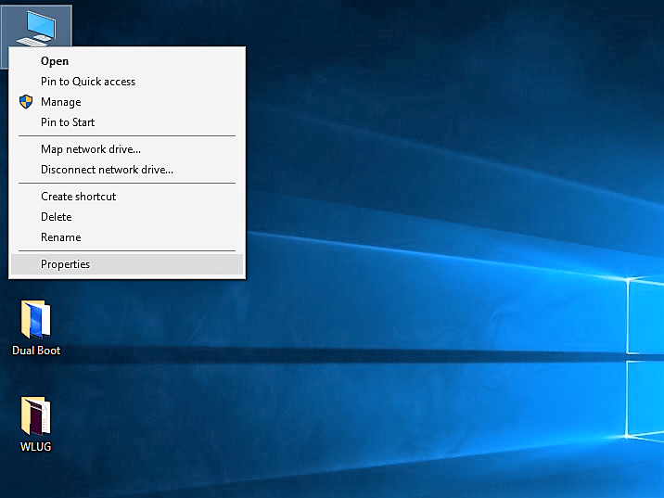
Windows Product ID
Right Click on
This PC and
Properties

Slide 18
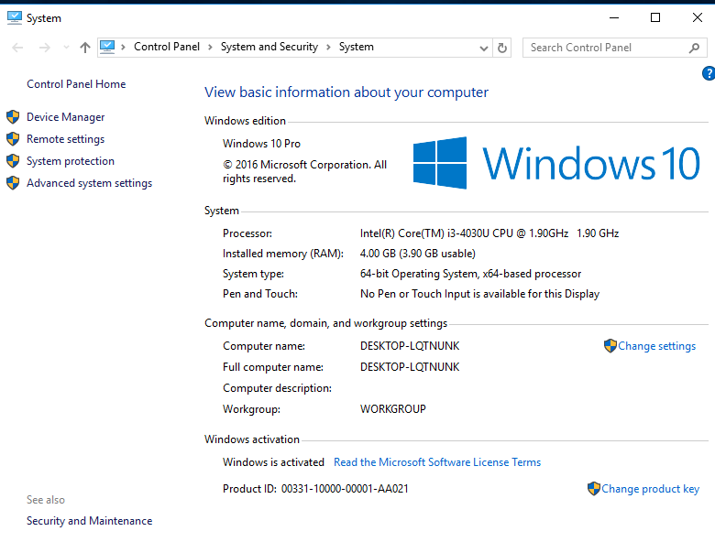
Note down the
Product ID

Slide 19
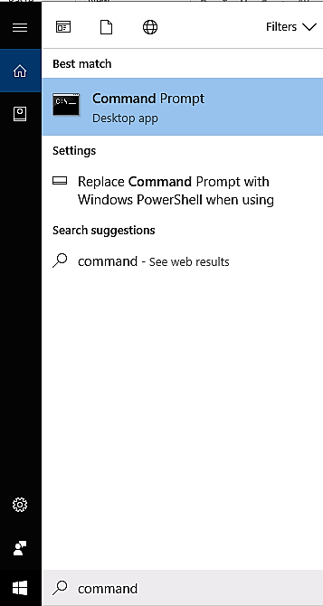
Partition Scheme: MBR or GPT ?
Command Prompt

Slide 20
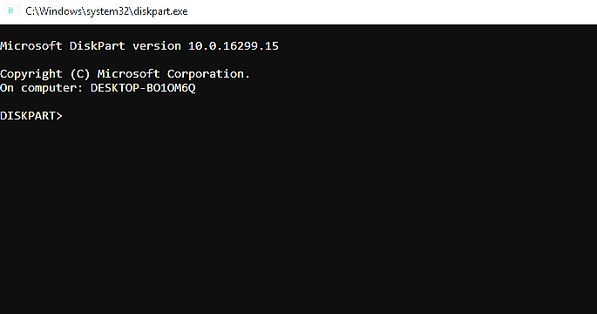

Slide 21
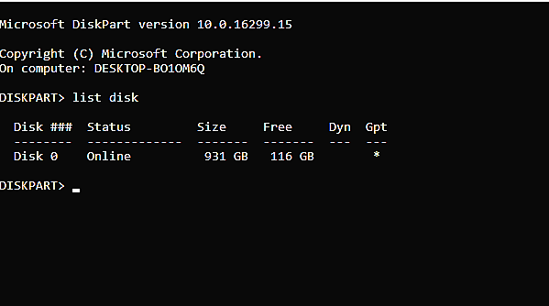
GPT

Slide 22
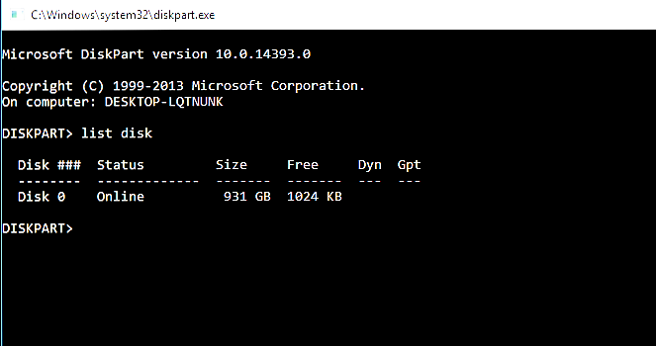
MBR

Slide 23
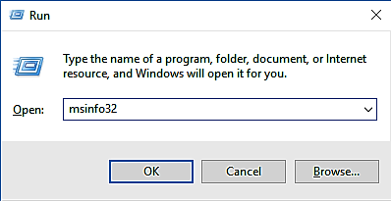
BIOS Mode : UEFI or Legacy ?
Windows + r

Slide 24
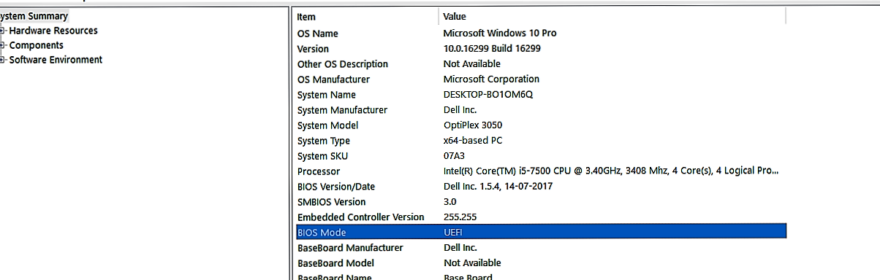
UEFI

Slide 25
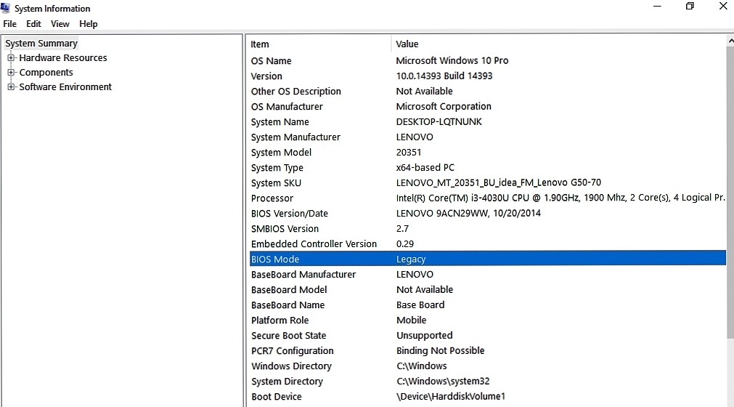
Legacy

Slide 26
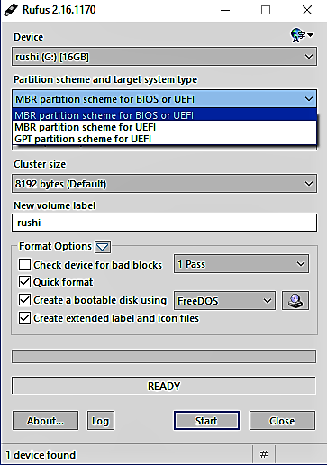
Bootable Disk
Open Rufus

Slide 27
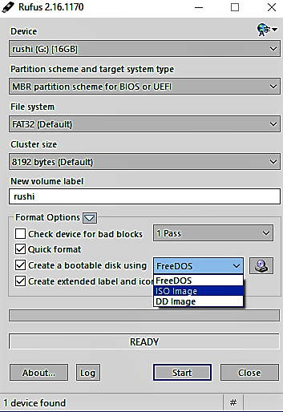
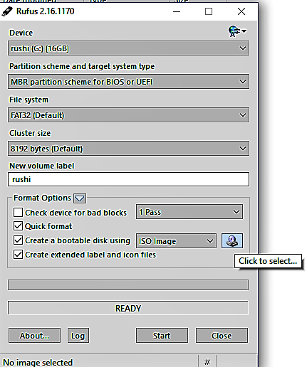

Slide 28
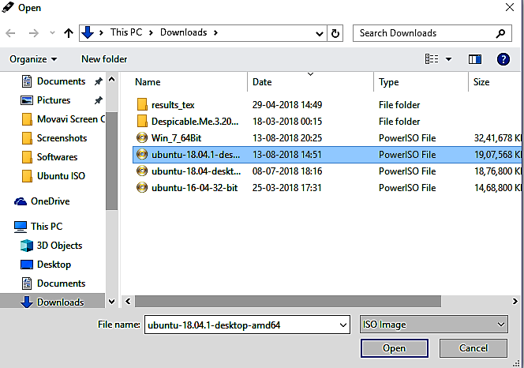
Browse the ISO Image

Slide 29
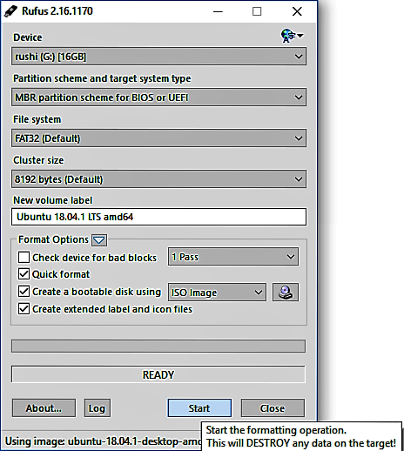
Click on Start

Slide 30
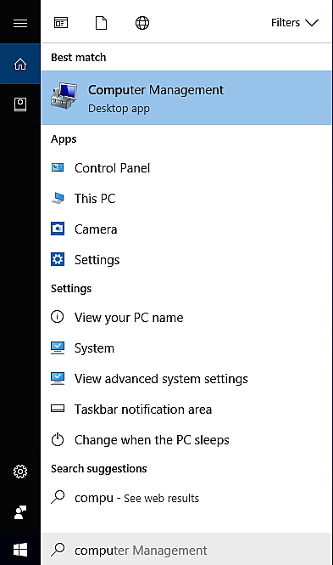
Disk Partition
Computer Management

Slide 31
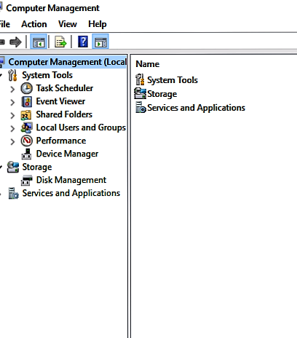
Click on Disk Management

Slide 32
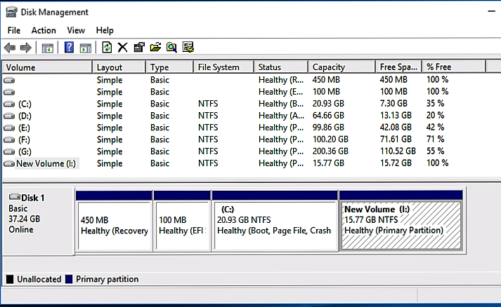
For GPT
Right Click on Drive
and Click on Shrink
Volume

Slide 33
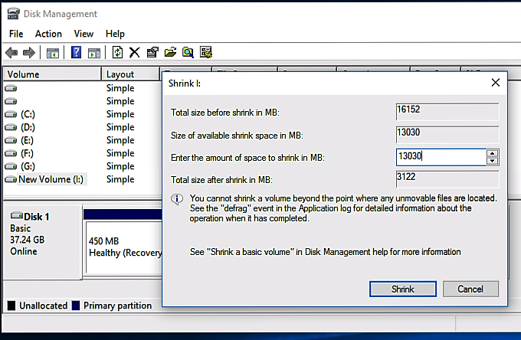
Shrink The Volume

Slide 34
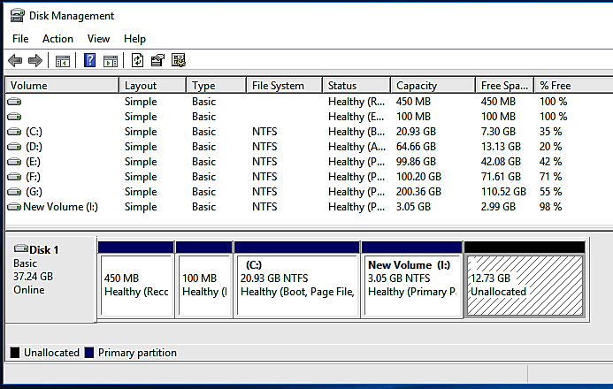

Slide 35
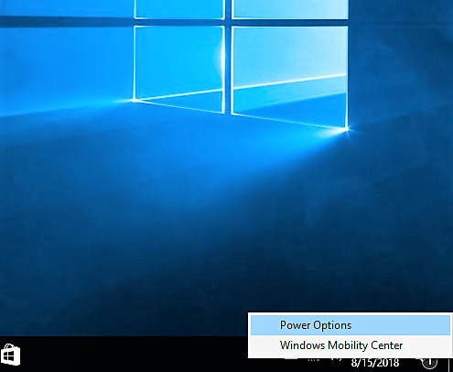
Fast Start Up
Right Click On Battery Icon
Select Power Options

Slide 36
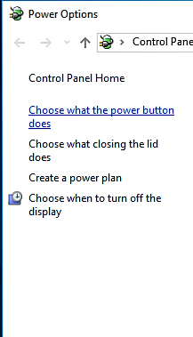
Click On
–Choose what the Power button does

Slide 37
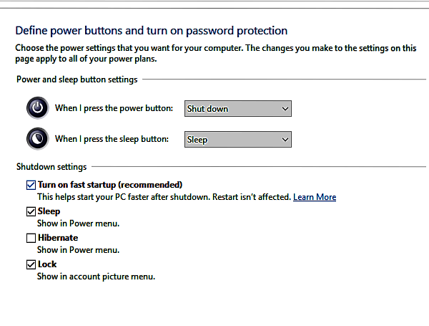
Un-tick the Fast Startup
Option
Click on Save Changes
Close The Window

Slide 38
Check For Bootable PD
If Completed , click on Close.
Re-Start the System

Slide 39
Keys
Company | BIOS Key | Boot Key
HP | F10 or Esc | F12 or Esc
DELL | F12 | F12
LENOVO | F2 | F12
ASUS | Esc | F9 or F8
ACER | F2 | F12

Slide 40
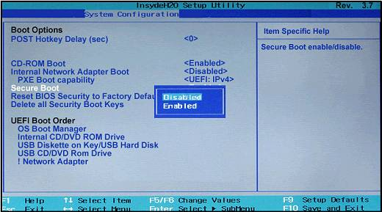
Secure Boot-OFF
Press BIOS Key
Go to System Conf.
Secure Boot
Click On Disables
Exit (Press F10)

Slide 41
Installation
Press Boot Key
Select Bootable Device (Your PD Name)

Slide 42
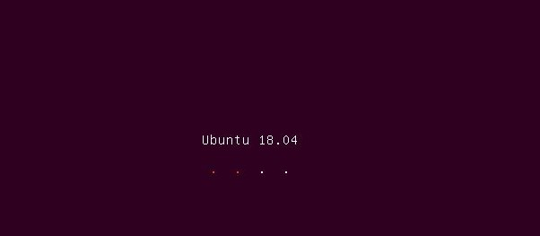

Slide 43
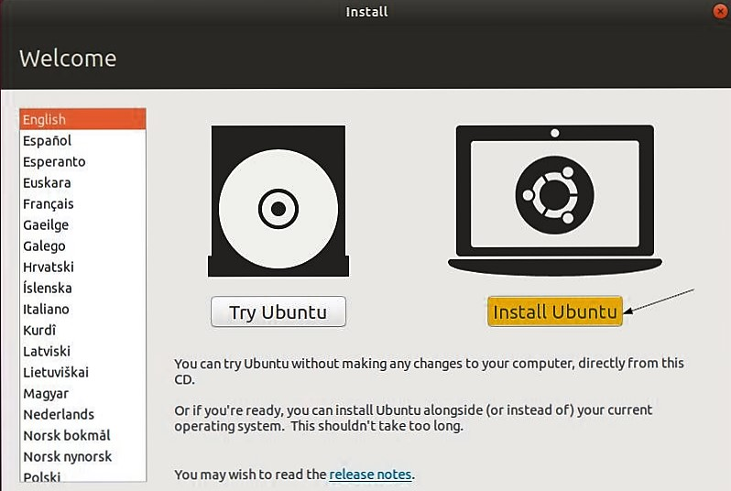
Click on Install Ubuntu

Slide 44
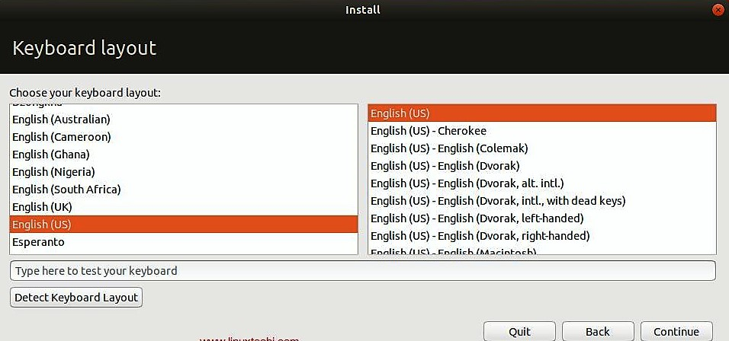
Select English And Click On Continue

Slide 45
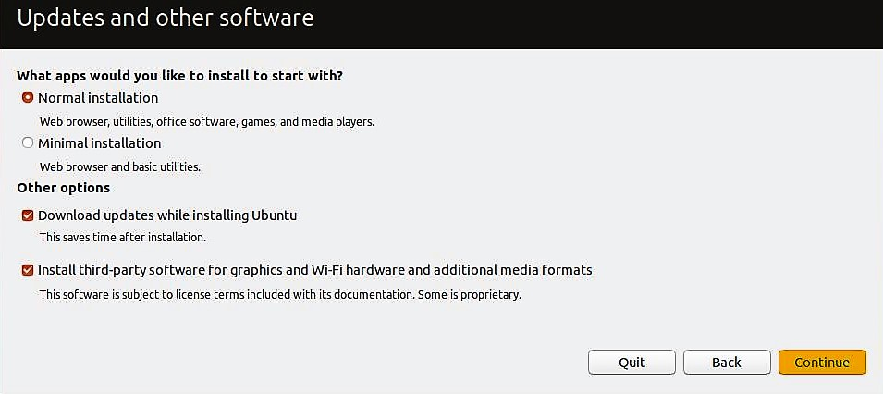
Un tick Last Two Options
And
Click on Continue

Slide 46
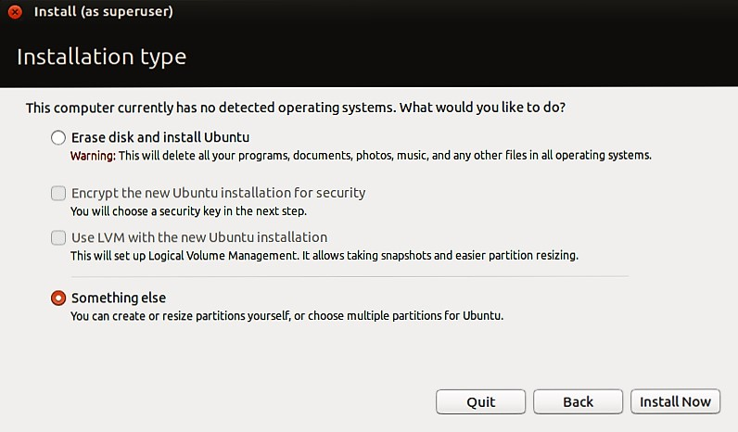
Select – Something else and
Click on Install Now

Slide 47
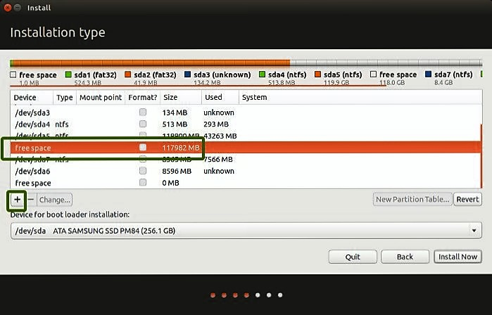
Select Free Space & Click on ‘+’

Slide 48
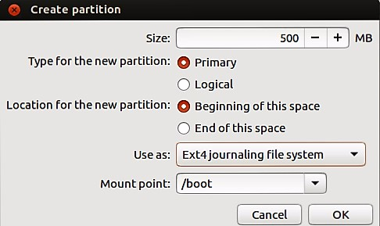
Boot Space
De-Select Primary
and
Select Logical
Click on OK

Slide 49
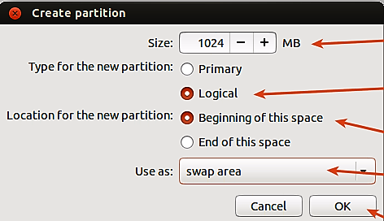
Swap Area
Click on OK

Slide 50
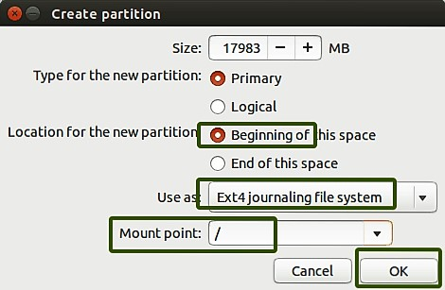
Root (/)
Click on OK

Slide 51
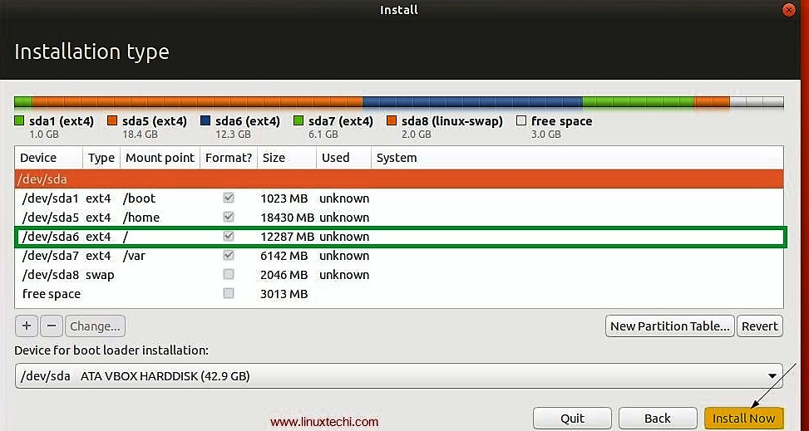
Select Root(/) And Then Click on Install Now

Slide 52
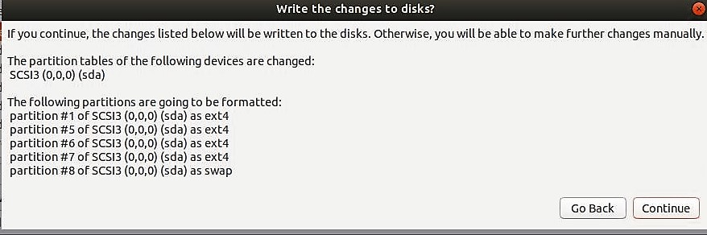
Click On Continue

Slide 53
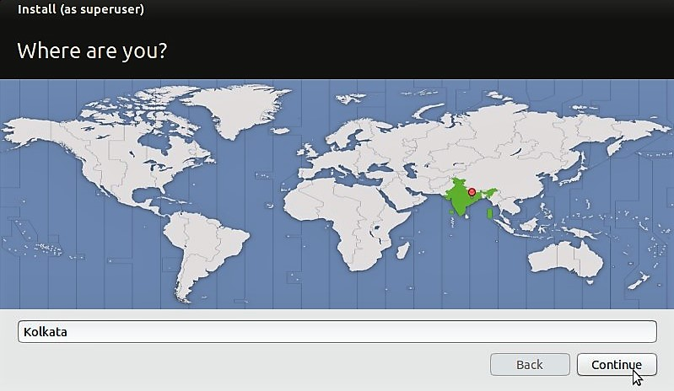
Select India & Click on Continue

Slide 54
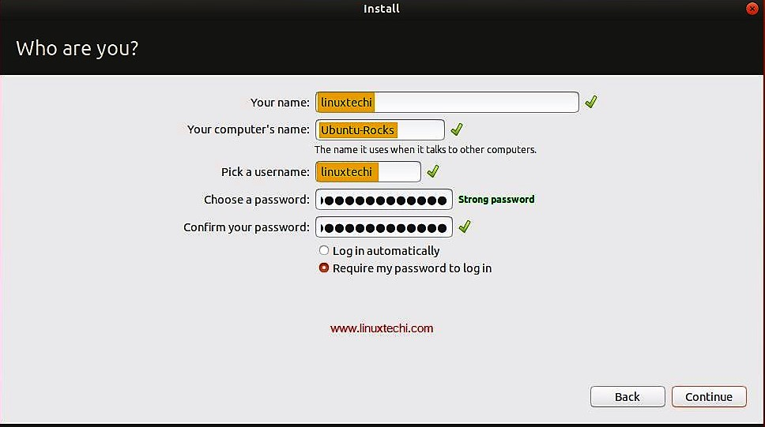
Set Your PC Name & Password

Slide 55
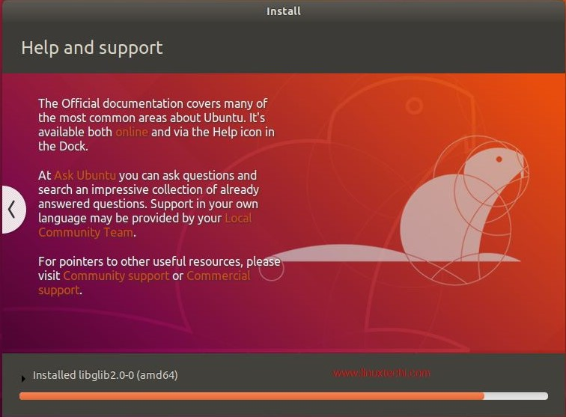
Installation Process Started

Slide 56
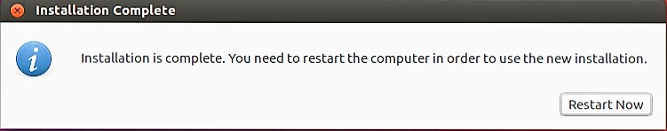
Installation Completed
Click on Restart Now & Remove The Pen Drive

Slide 57
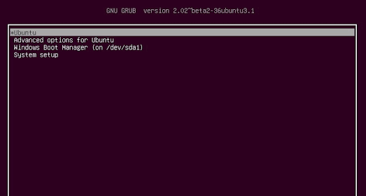
Select Ubuntu & Press Enter

Slide 58
Done With Installation

Slide 59
Install updates for Ubuntu 18.04 LTS
Open terminal using ctrl+alt+t
sudo apt-get update
sudo apt-get upgrade
Notes:
59

Slide 60
Install Important softwares
sudo apt-get install gnome-tweaks
sudo apt-get install gcc
sudo apt-get install g++
sudo apt-get install vlc
Notes:
60

